Slide 1
22CS204-JAVA PROGRAMMING
MODULE-1 UNIT-1
INTRODUCTION: History of Java, Byte code, JVM, Java buzzwords, OOP principles, Data types, Variables, Scope of variables, Operators, Control statements, Type conversion and casting, Arrays.
Concepts Of Classes and Objects: Introduction to methods, Method overloading, Constructors, Constructor overloading, Usage of static with data and method, Access control, this key word, Garbage collection, String class, String Tokenizer
UNIT-2 INHERITANCE AND EXCEPTIONS
Inheritance: Types of inheritance, Member access rules, Usage of super keyword, Method overriding, Usage of ﬁnal keyword, Abstract classes, Interfaces - diﬀerences between abstract classes and interfaces, deﬁning an interface, implementing interface, applying interfaces, variables in interface and extending interfaces. Packages-deﬁning, creating and accessing a package, importing packages, access control in packages
Exception Handling: Concepts of exception handling, Types of exceptions, Usage of try, catch, throw, throws and ﬁnally keywords, Built-in exceptions, User deﬁned exception

Slide 2
Program:-
Collection of Instructions or Statements is called a Program
Instructions or Statements:-
A line ends with (;) is called instruction or statement
Software
Collections of Programs is called a Software or
Programs that are used to solve to a specific problem is called a software
The software is mainly divided into two types
1. System Software eg:Operating System eg:Ms-Dos,windows,Linux
2. Application Software eg:Ms-office

Slide 3
Programming Language:
A programming language is a language that can be controlled by machine that is called “Programming Language”
Eg:
ALGOL - Algorithmic Language, computer programming language designed by an international committee of the Association of Computing Machinery (ACM), led by Alan J. Perlis of Carnegie Mellon University, during 1958–60 for publishing algorithms, as well as for doing computations
BCPL- BCPL (Basic combined Programming Language) was first implemented by Martin Richards of the University of Cambridge in 1967
BCPL-1967 - Martin Richards
B- 1969 - Ken Thompson
C- 1972 - Dennis Ritchie
C++ 1979 - Bjarne Stroustrup
JAVA-1995- James Gosling

Slide 4
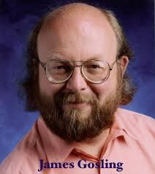
HISTORY OF JAVA
In 1990, Sun Microsystem Inc.(US) has conceived a project to develop software for consumer electronic devices that could be controlled by a remote. This Project was called “Stealth Project” but later its name was changed to “Green Project”
In January 1991, Bill joy, James Gosling,Mike Sheradin,Patrick Naughton, and several others met in Aspen, Colorado to discuss this Project.
Mike Sheradin was to focus on business development. Patrick Naughton was to begin work on the graphics System. And James Gosling was to identify the Proper programming language for the project.
Gosling thought C and C++ could be used to develop the project. But the Problem he faced with them is that they were system dependent language and hence could not be used on various processors, which the electronic devices might use.
So he started developing a new language , which was completely system independent. This language was initially called “Oak” . Since This name was registered by some other company , later it was changed to “Java”

Slide 5
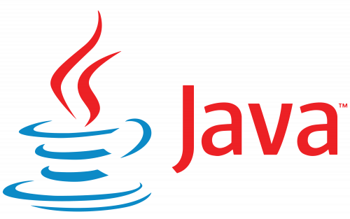
Why the name java
James Gosling and his team members were consuming a lot of coffee while developing this language.
They felt that they were able to develop a better language because of the good quality coffee they consumed.
So the coffee had its own role in developing this language because of the good quality coffee was exported to the entire world from a place called “Java island”
Hence they fixed the name of the place for the language as “Java”. Thus , the symbol for java language is
coffee cup and saucer.
By September of f1994 , Naughton and Jonathan Payne
started writing Web Runner
Sun formally announced java and Hot java at
SunWorld conference in 1995
On january 23 rd 1996 ,JDK 1.0 Version was release.

Slide 6
Brief HISTORY OF JAVA
High-level programming language.
Introduced in 1995 by Sun Microsystems, now a subsidiary of Oracle Corporation.
1991: James Gosling- oak --→ Later Name it as JAVA.
1995: Java 1.0 was released to the public.
Slogan: "Write Once, Run Anywhere,“.
1996: Sun Microsystems released Java 1.1, which introduced inner classes, JDBC.
1998: Java 2 (J2SE) was released - JDK & JRE.
2004: J2SE 5.0 was released.
2006: Sun Microsystems released Java SE 6.
2014: Java 8 was released-API, 2017: Java 9 was released-JVM
2018: Java 10 was released.
2019: Java 11 was released- HTTP.
2021: Java 16 was released.-Improvements in Garbage Collector.
2023: September 19 Java 21 was released,

Slide 7
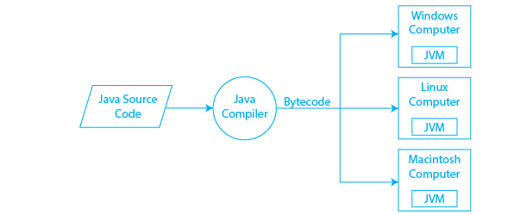

EXECUTION OF A JAVA PROGRAM
Jvm converts byte code into machine code based on operating System
One.class
One.java
Javac One.java

Slide 8
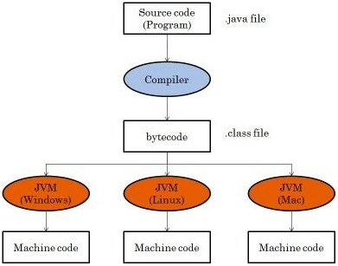
BYTE CODE
Bytecode in Java is a low-level representation of Java code.
Bytecode executed by JVM.

Slide 9
Java bytecode is similar to machine code.
Java bytecode is typically stored in files with a ".class" extension.
These files can be executed using the "java" command.
Advantages of using bytecode is that it allows Java to be a platform-independent language.
Java code can be compiled once and run on any platform that has a JVM installed.

Slide 10
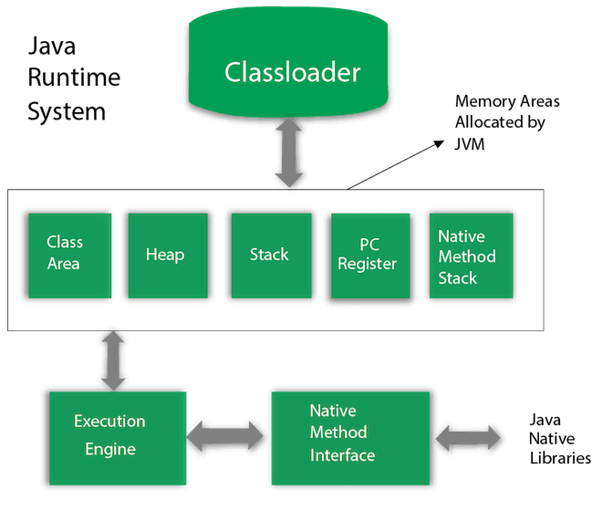
JVM(java virtual machine)
JVM Architecture

Slide 11
Jvm is the heart of entire java program execution process.
It is responsible for taking the .class file and converting each byte code instruction into the machine language instruction that can be executed by the microprocessor.
JVM Provides runtime environment for Java applications.
JVM provides several services:
memory management
garbage collection
Security
class loading
optimizing the performance of JIT (just-in-time compilation).

Slide 12
JVM components:
class loader: loads classes into the JVM's memory.
runtime data area: stores data and bytecode.
execution engine: interprets and executes the bytecode.
The JVM performs following operation:
Loads code
Verifies code
Executes code
Provides runtime environment.

Slide 13
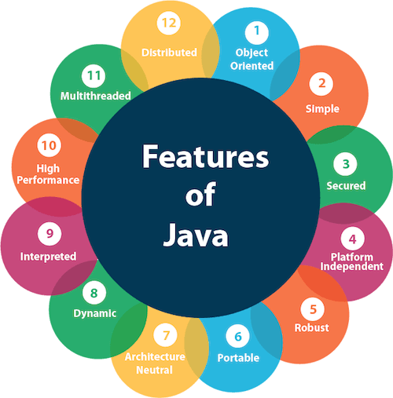
JAVA BUZZWORDS or FEATURES OF JAVA

Slide 14
Simple
Object-Oriented
Robust
Secure
Multithreaded
Portable
High-performance-JIT
Distributed
Dynamic
Architecture-neutral
Platform Independent: OS

Slide 15
1. Simple:
First of all , the difficult concepts of C and C++ have been omitted in java
People maintained the same syntax of C and C++ in java.
2. Object-Oriented
java is an object oriented programming language.
3.Robust
Robust means strong .Java programs are strong and they don’t crash easily like a C or C++ program. There are two reasons for this. 1. Java has got excellent inbuilt exceptions
2.Memory management Features.
4. Secure:
security problems like eavesdropping, Tampering, Impersonation, and virus threats can be eliminated or minimized by using Java on internet.

Slide 16
5. Multithreaded:-
Creating multiple threads is called multithreaded. Java support multithreaded
Concepts.
6. Portable:
if a program yields the same result on every machine, then that program is called portable. Java programs are portable.
7. High-performance:-
java soft people have introduced JIT(just in time) compiler, which enhances the speed of execution. So now in JVM,both interpreter and JIT compiler work together to run the program.
8. Distributed:-
Information is distributed on various computers on a network.java can handle the protocols like TCP/IP and UDP.

Slide 17
9. Dynamic:
Before the development of java, only static text used to be displayed in the browser. After developing java animation was done using an applet program. Which is the dynamically interacting program on internet.
10. Architecture-neutral
Java is architecture neutral because there are no implementation dependent features, for example, the size of primitive types is fixed. In C programming, int data type occupies 2 bytes of memory for 32-bit architecture and 4 bytes of memory for 64-bit architecture.
11. Platform Independent:
java byte code is not machine dependent. It can be run on any machine with any processor and any operating system.

Slide 18
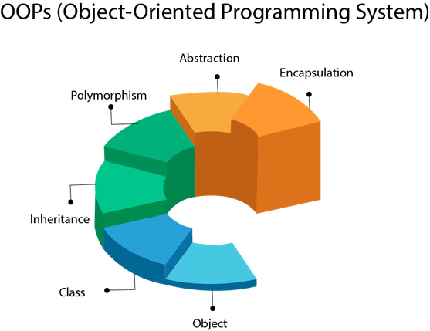
OOP (Object-Oriented Programming) Concepts in JAVA

Slide 19
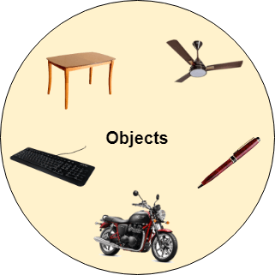
Object
An entity that has state and behavior is known as an object e.g., chair, bike, marker, pen, table, car, etc.

Slide 20
Class:
a class is a model for creating object. A class contain properties and actionse. A class donest exist physically.
Eg: fruits,person,
Inheritance
Providing a new class based on the existing class. Is called inheritance
Polymorphism
If one task is performed in different ways, it is known as polymorphism.
In Java, we use method overloading and method overriding to achieve polymorphism.

Slide 21
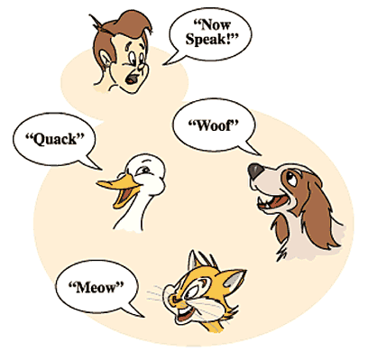
Example:

Slide 22

Abstraction
Hidding the unnecessary data from the user.
Encapsulation
Taking the data and code as a single unit is called encapsulation

Slide 23
Naming Conventions in java or Rules to be followed by a java programmer
A package represents a sub directory that contains a group of classes and interfaces. Names of packages in java are written in small letters as
eg:java.awt , jva.io, javax.swing
An interface is also similar to a class. Each of class names and interface names start with a Capital letter
eg:String , DataInputStream, ActionListener
A class and an interface contain methods and variables. The first word of a method name is in small letter. Then from second word onwards, each new word starts with a capital letter.
eg: println(), readLine()
The naming convention for variables names is same as that for methods
eg: age,empName
Constants represent fixed values that cannot be altered. Such constants should be written by using all capital letters
eg:PI,MAX_VALUE,Font.BOLD
All keywords should be written by using all small letters
eg: public,static void

Slide 24
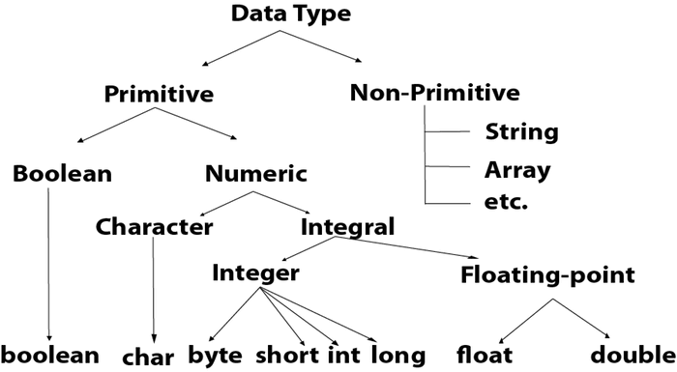
Data Types in Java
1.Primitive data types
2. Non-primitive data types or Reference data types

Slide 25
Data Type | Default Value | Default size
boolean | false | 1 bit
char | '\u0000' | 2 byte
byte | 0 | 1 byte
short | 0 | 2 byte
int | 0 | 4 byte
long | 0L | 8 byte
float | 0.0f | 4 byte
double | 0.0d | 8 byte

Slide 26
Variables
A variable is a memory location where we need to store the data
Declaring Variables
Syntax:
dataType variableName; // Declaration without initialization
dataType variableName = initialValue; // Declaration with initialization
Examples:
int age;
double salary = 50000.50;
String name, address;
Assigning Values to Variables:
age = 25
Using Variables:
int x = 10;
int y = 20;
int sum = x + y;
System.out.println("The sum of x and y is: " + sum);

Slide 27
Variable Naming Rules
Variable names must start with a letter, underscore (_), or dollar sign ($).
After the first character, variable names can contain letters, digits, underscores, and dollar signs.
Java is case-sensitive, so myVariable and myvariable are considered as different variables.
Avoid using reserved keywords as variable names (e.g., int, double, class, etc.).
Example:
int _count = 10; // Valid variable name
String $name = "John"; // Valid variable name
double 3percent = 0.03; // Invalid variable name (starts with a digit)
boolean class = true; // Invalid variable name (uses a reserved keyword)
Constant Variables (Final Variables): You can declare variables as constants using the final keyword. Once assigned, the value of a final variable cannot be changed.
Example:
final int MAX_SIZE = 100; // Declaring a constant variable

Slide 28
How to compile and execute a java programs
At first, check that Java is installed in your system and the path is properly set then we will see how to run the java program. If Java is not installed on the system or path is not defined properly, then we can’t run any Java programs on our system. After the JDK installation, compiling and running the java program is very easy.
A java file is compiled using the javac command which generates a platform-independent bytecode that can be executed in any machine by a Java Virtual Machine (JVM). The bytecode is executed using the java command which executes the bytecode and produces the result.
How to Run a Java Program Using Command Prompt and Notepad?
Here we will be using Notepad and Command Prompt to run the Java programs. Let's see the process step-by-step:
Create a new folder. Where u want to create
Go to the folder, and make the new file with .Java file in that folder.
for this press windows button+r

Slide 29
3. The run will open
4. With in the run type notepad
5. The notepad will be opened
6. Type the java program
7. save the file press (ctrl+s--→filename.java)
8 .After that, again press press windows+r and type CMD.
9. Now, CMD will open on that folder.
10 Just type javac file_name.java
11.You will see that a new file will be created in the same folder with extension .class.
12. After getting .class file run the java file.
13. For Running .class file using javac classname
Hit enter and you will see the output in the window.

Slide 30
Write a java program to demonstrative data types
class One
{
public static void main(String args[])
{
int myNum = 5;
float f1 = 5.99f;
char myletter = 'D';
boolean one = true;
String myText = "Hello";
double d1=5.3;
byte b=122;
long l=10L;
short s=123;

Slide 31
System.out.println(" The Integer variab value is::"+myNum);
System.out.println(" The Float value is::"+f1);
System.out.println(" The Character value is::"+myletter);
System.out.println("The Boolean variable value is::"+one);
System.out.println("The String is::"+myText);
System.out.println("The Double value is::"+d1);
System.out.println("The Byte value is::"+b);
System.out.println("The Long value is::"+l);
System.out.println("The Short value is::"+s);
}
}

Slide 32
Output:-
E:\java programs>javac Variable.java
E:\java programs>java One
The Integer variab value is::5
The Float value is::5.99
The Character value is::D
The Boolean variable value is::true
The String is::Hello
The Double value is::5.3
The Byte value is::122
The Long value is::10
The Short value is::123

Slide 33
Scope of variables in java
Class Scope (Instance Variables)
Method Scope (Local Variables)
Block Scope
Static Scope (Class Variables)

Slide 34
Scope of variables in java
Class Scope (Instance Variables): within a class but outside of any method or block.
Example:
public class MyClass
{
int instanceVariable; // This is an instance variable.
public void someMethod()
{
// This method can access and modify the instanceVariable.
instanceVariable = 10;
}
}

Slide 35
Method Scope (Local Variables):declared within a method or a block of code (such as for loops, if statements).
Example:
public class MyClass
{
public void someMethod()
{
int localVar = 5; // This is a local variable.
// localVar can only be accessed within this method.
System.out.println(localVar);
}
}

Slide 36
Block Scope:Variables declared within a block of code (enclosed by curly braces) have block scope.
Example:
public class MyClass
{
public void someMethod()
{
if (true)
{
int blockVar = 20; // This is a block-scoped variable.
// blockVar can only be accessed within this if block.
System.out.println(blockVar);
}
// blockVar is not accessible here.
}
}

Slide 37
Static Scope (Class Variables): Static variables are associated with the class itself rather than with instances of the class. They are declared using the static keyword and exist as long as the program is running.
Example:
public class MyClass
{
static int staticVar; // This is a static variable.
public void someMethod()
{
staticVar = 30; // Accessing the static variable.
}
}

Slide 38
Operators in Java
Unary Operator,
Arithmetic Operator
Shift Operator
Relational Operator
Bitwise Operator
Logical Operator
Ternary Operator and
Assignment Operator.

Slide 39
Operator Type | Category | Precedence
Unary | postfix | expr++ expr--
 | prefix | ++expr --expr +expr -expr ~ !
Arithmetic | multiplicative | * / %
 | additive | + -
Shift | shift | << >> >>>
Relational | comparison | < > <= >= instanceof
 | equality | == !=
Bitwise | bitwise AND | &
 | bitwise exclusive OR | ^
 | bitwise inclusive OR | |
Logical | logical AND | &&
 | logical OR | ||
Ternary | ternary | ? :
Assignment | assignment | = += -= *= /= %= &= ^= |= <<= >>= >>>=

Slide 40
Java Unary Operator
Example1: ++ and --
public class OperatorExample{
public static void main(String args[]){
int x=10;
System.out.println(x++);//10 (11)
System.out.println(++x);//12
System.out.println(x--);//12 (11)
System.out.println(--x);//10
}}
Example2: ++ and --
public class OperatorExample{
public static void main(String args[]){
int a=10;
int b=10;
System.out.println(a++ + ++a);//10+12=22
System.out.println(b++ + b++);//10+11=21
}
}

Slide 41
Example: ~ !
public class OperatorExample{
public static void main(String args[]){
int a=10;
int b=-10;
boolean c=true;
boolean d=false;
System.out.println(~a);//-11 (minus of total positive value which starts from 0)
System.out.println(~b);//9 (positive of total minus, positive starts from 0)
System.out.println(!c);//false (opposite of boolean value)
System.out.println(!d);//true
}
}

Slide 42
Java Arithmetic Operators
EX1
public class OperatorExample{
public static void main(String args[]){
int a=10;
int b=5;
System.out.println(a+b);//15
System.out.println(a-b);//5
System.out.println(a*b);//50
System.out.println(a/b);//2
System.out.println(a%b);//0
}
}
EX2
public class OperatorExample{
public static void main(String args[]){
System.out.println(10*10/5+3-1*4/2);
}
}

Slide 43
Java Left Shift Operator
public class OperatorExample{
public static void main(String args[]){
System.out.println(10<<2);//10*2^2=10*4=40
System.out.println(10<<3);//10*2^3=10*8=80
System.out.println(20<<2);//20*2^2=20*4=80
System.out.println(15<<4);//15*2^4=15*16=240
}
}

Slide 44
Java Right Shift Operator
public Class OperatorExample{
public static void main(String args[]){
System.out.println(10>>2);//10/2^2=10/4=2
System.out.println(20>>2);//20/2^2=20/4=5
System.out.println(20>>3);//20/2^3=20/8=2
}
}

Slide 45
Logical && and Bitwise &
The logical && operator doesn't check the second condition if the first condition is false. It checks the second condition only if the first one is true.
The bitwise & operator always checks both conditions whether first condition is true or false.
Ex:public class OperatorExample{
public static void main(String args[]){
int a=10;
int b=5;
int c=20;
System.out.println(a<b&&a<c);//false
System.out.println(a<b&a<c);//false
}}

Slide 46
Logical || and Bitwise |
public class OperatorExample{
public static void main(String args[]){
int a=10;
int b=5;
int c=20;
System.out.println(a>b||a<c);//true
System.out.println(a>b|a<c);//true
}}

Slide 47
Java Ternary Operator Example
public class OperatorExample{
public static void main(String args[]){
int a=2;
int b=5;
int min=(a<b)?a:b; //2
System.out.println(min);
}
}

Slide 48
Java Assignment Operator
public class OperatorExample{
public static void main(String[] args){
int a=10;
a+=3;//10+3
System.out.println(a);
a-=4;//13-4
System.out.println(a);
a*=2;//9*2
System.out.println(a);
a/=2;//18/2
System.out.println(a);
}
}

Slide 49
public class OperatorExample{
public static void main(String args[]){
short a=10;
short b=10;
//a+=b;//a=a+b internally so fine
a=a+b;//Compile time error because 10+10=20 now int
System.out.println(a);
}}
O/P: Compile time error
Applying Type Casting
public class OperatorExample{
public static void main(String args[]){
short a=10;
short b=10;
a=(short)(a+b);//20 which is int now converted to short
System.out.println(a);
}}

Slide 50
Java Keywords- Assignment1-Come with Purpose(usage) of All Keywords

Slide 51
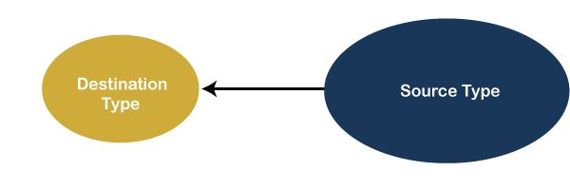
type casting
float b = 3.5;
int a = (int) b; // converting a float value into integer

Slide 52
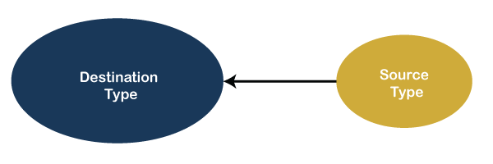
type conversion
int a = 20;
Float b;
b = a; // Now the value of variable b is 20.000

Slide 53
Difference Between Type Casting and Type Conversion
S.N. | Type Casting | Type Conversion
1 | Type casting is a mechanism in which one data type is converted to another data type using a casting () operator by a programmer. | Type conversion allows a compiler to convert one data type to another data type at the compile time of a program or code.
2 | It can be used both compatible data type and incompatible data type. | Type conversion is only used with compatible data types, and hence it does not require any casting operator.
3 | It requires a programmer to manually casting one data into another type. | It does not require any programmer intervention to convert one data type to another because the compiler automatically compiles it at the run time of a program.
4 | It is used while designing a program by the programmer. | It is used or take place at the compile time of a program.
5 | When casting one data type to another, the destination data type must be smaller than the source data. | When converting one data type to another, the destination type should be greater than the source data type.
6 | It is also known as narrowing conversion because one larger data type converts to a smaller data type. | It is also known as widening conversion because one smaller data type converts to a larger data type.
7 | It is more reliable and efficient. | It is less efficient and less reliable.
8 | There is a possibility of data or information being lost in type casting. | In type conversion, data is unlikely to be lost when converting from a small to a large data type.
9 | float b = 3.0; int a = (int) b | int x = 5, y = 2, c; float q = 12.5, p; p = q/x;

Slide 54
Java Control Statements
Decision Making statements(or) Selection Statements
if statements
switch statement
Loop statements (or) Iteration statements
do while loop
while loop
for loop
for-each loop
Jump statements (or) Branching statements
break statement
continue statement

Slide 55
Decision-Making statements
1) If Statement:
Simple if statement
if-else statement
if-else-if ladder
Nested if-statement
1) Simple if statement:
if(condition)
{
statement 1; //executes when condition is true
}

Slide 56
Example:
public class Student
{
public static void main(String[] args)
{
int x = 10;
int y = 12;
if(x+y > 20)
{
System.out.println("x + y is greater than 20");
}
}
}

Slide 57
2) if-else statement
if(condition)
{
statement 1; //executes when condition is true
}
Else
{
statement 2; //executes when condition is false
}

Slide 58
Example:
public class Student {
public static void main(String[] args) {
int x = 10;
int y = 12;
if(x+y < 10)
{
System.out.println("x + y is less than 10");
}
else
{
System.out.println("x + y is greater than 20");
}
}
}

Slide 59
3) if-else-if ladder:
if(condition 1)
{
statement 1; //executes when condition 1 is true
}
else if(condition 2)
{
statement 2; //executes when condition 2 is true
}
else
{
statement 2; //executes when all the conditions are false
}

Slide 60
public class Student {
public static void main(String[] args) {
String city = "Delhi";
if(city == "Meerut")
{
System.out.println("city is meerut");
}
else if (city == "Noida")
{
System.out.println("city is noida");
}
else if(city == "Agra")
{
System.out.println("city is agra");
}
else
{
System.out.println(city);
}
}
}

Slide 61
4. Nested if-statement
if(condition 1)
{
statement 1; //executes when condition 1 is true
if(condition 2)
{
statement 2; //executes when condition 2 is true
}
else
{
statement 2; //executes when condition 2 is false
}
}

Slide 62
Example:
import java.util.*;
import java.lang.*;
import java.io.*;
class GFG
{
public static void main(String args[])
{
int a=10;
int b=20;
if(a==10){
if(b==20){
System.out.println("GeeksforGeeks");
}
}
}
}

Slide 63
Switch Statement
switch (expression)
{
case value1:
statement1;
break;
.
.
.
case valueN:
statementN;
break;
default:
default statement;
}

Slide 64
Example:
public class Student implements Cloneable {
public static void main(String[] args) {
int num = 2;
switch (num){
case 0:
System.out.println("number is 0");
break;
case 1:
System.out.println("number is 1");
break;
default:
System.out.println(num);
}
}
}

Slide 65
Practice:
1) Write a Java program to get a number from the user and print whether it is positive or negative.
Test Data Input number: 35 Expected Output : Number is positive
2) Write a Java program to solve quadratic equations (use if, else if and else).
Test Data Input a: 1 Input b: 5 Input c: 1 Expected Output : The roots are -0.20871215252208009 and -4.7912878474779195
3)Write a Java program that takes three numbers from the user and prints the greatest number.
Test Data Input the 1st number: 25 Input the 2nd number: 78 Input the 3rd number: 87 Expected Output : The greatest: 87

Slide 66
4) Write a Java program that reads a floating-point number and prints "zero" if the number is zero. Otherwise, print "positive" or "negative". Add "small" if the absolute value of the number is less than 1, or "large" if it exceeds 1,000,000.
Test Data
Input a number: 25
Expected Output :
Input value: 25
Positive number

Slide 67
5. Write a Java program that takes a number from the user and generates an integer between 1 and 7. It displays the weekday name.
Test Data Input number: 3 Expected Output : Wednesday
6. Write a Java program to find the number of days in a month.
Test Data Input a month number: 2 Input a year: 2016 Expected Output : February 2016 has 29 days

Slide 68
7. Write a Java program that takes a year from the user and prints whether it is a leap year or not.
Test Data Input the year: 2016 Expected Output : 2016 is a leap year

Slide 69
Loop Statements
1) for loop
2) while loop
3) do-while loop
for loop
for(initialization, condition, increment/decrement)
{
//block of statements
}

Slide 70
public class Calculattion
{
public static void main(String[] args)
{
int sum = 0;
for(int j = 1; j<=10; j++)
{
sum = sum + j;
}
System.out.println("The sum of first 10 natural numbers is " + sum);
}
}
O/P:55

Slide 71
for-each loop
for(data_type var : array_name/collection_name)
{
//statements
}
EX:
public class Calculation {
public static void main(String[] args) {
String[] names = {"Java","C","C++","Python","JavaScript"};
System.out.println("Printing the content of the array names:\n");
for(String name:names) {
System.out.println(name);
}
}
}

Slide 72
while loop
while(condition)
{
//looping statements
}
EX:
public class Calculation {
public static void main(String[] args) {
int i = 0;
System.out.println("Printing the list of first 10 even numbers \n");
while(i<=10)
{
System.out.println(i);
i = i + 2;
}
}
}

Slide 73
do-while loop
do
{
//statements
} while (condition);
EX:
public class Calculation {
public static void main(String[] args) {
int i = 0;
System.out.println("Printing the list of first 10 even numbers \n");
do {
System.out.println(i);
i = i + 2;
}while(i<=10);
}
}

Slide 74
Jump Statements
break statement:
public class BreakExample {
public static void main(String[] args) {
for(int i = 0; i<= 10; i++)
{
System.out.println(i);
if(i==6)
{
break;
}
}
}
}

Slide 75
continue statement
class Main {
public static void main(String[] args) {
for (int i = 1; i <= 10; ++i)
{
if (i > 4 && i < 9)
{
continue;
}
System.out.println(i);
}
}
}

Slide 76
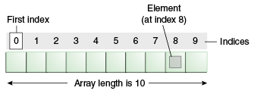
Arrays
Advantages
Code Optimization
Random access
Disadvantages
Size Limit (Solve by collections)

Slide 77
Types of Array in java
Single Dimensional Array
Multidimensional Array
Single Dimensional Array in Java
Syntax:
datatype[] arr;
(or)
datatype []arr;
(or)
datatype arr[];

Slide 78
Instantiation of an Array in Java
class Testarray{
public static void main(String args[]){
int a[]=new int[5];//declaration and instantiation
a[0]=10;//initialization
a[1]=20;
a[2]=70;
a[3]=40;
a[4]=50;
//traversing array
for(int i=0;i<a.length;i++)//length is the property of array
System.out.println(a[i]);
}
}

Slide 79
declaration, instantiation and initialization
class Testarray1{
public static void main(String args[]){
int a[]={33,3,4,5};//declaration, instantiation and initialization
//printing array
for(int i=0;i<a.length;i++)//length is the property of array
System.out.println(a[i]);
}
}

Slide 80
For-each Loop for Java Array
class Testarray1
{
public static void main(String args[])
{
int arr[]={33,3,4,5};
//printing array using for-each loop
for(int i:arr)
System.out.println(i);
}
}

Slide 81
ArrayIndexOutOfBoundsException in a Java Array
public class TestArrayException
{
public static void main(String args[])
{
int arr[]={50,60,70,80};
for(int i=0;i<=arr.length;i++) or (for(int i=0;i<=arr.length-1;i++)
{
System.out.println(arr[i]);
}
}
}

Slide 82
Multidimensional Array in Java
Syntax:
datatype[][] arrayRefVar;
(or)
datatype [][]arrayRefVar;
(or)
datatype arrayRefVar[][];
(or)
datatype []arrayRefVar[];

Slide 83
EX:
int[][] arr=new int[3][3];//3 row and 3 column
EX:
arr[0][0]=1;
arr[0][1]=2;
arr[0][2]=3;
arr[1][0]=4;
arr[1][1]=5;
arr[1][2]=6;
arr[2][0]=7;
arr[2][1]=8;
arr[2][2]=9;

Slide 84
EX:
class Testarray3{
public static void main(String args[]){
//declaring and initializing 2D array
int arr[][]={{1,2,3},{2,4,5},{4,4,5}};
//printing 2D array
for(int i=0;i<3;i++)
{
for(int j=0;j<3;j++)
{
System.out.print(arr[i][j]+" ");
}
System.out.println();
}
}
}

Slide 85
Jagged Array in Java
If we are creating odd number of columns in a 2D array, it is known as a jagged array. In other words, it is an array of arrays with different number of columns.
EX:
class TestJaggedArray{
public static void main(String[] args){
//declaring a 2D array with odd columns
int arr[][] = new int[3][];
arr[0] = new int[3];
arr[1] = new int[4];
arr[2] = new int[2];

Slide 86
//initializing a jagged array
int count = 0;
for (int i=0; i<arr.length; i++)
for(int j=0; j<arr[i].length; j++)
arr[i][j] = count++;
//printing the data of a jagged array
for (int i=0; i<arr.length; i++){
for (int j=0; j<arr[i].length; j++){
System.out.print(arr[i][j]+" "); Output: 0 1 2
} 3 4 5 6
System.out.println();//new line 7 8
}
}
}

Slide 87
Addition of two matrices
class Testarray5{
public static void main(String args[]){
//creating two matrices
int a[][]={{1,3,4},{3,4,5}};
int b[][]={{1,3,4},{3,4,5}};
//creating another matrix to store the sum of two matrices
int c[][]=new int[2][3];
//adding and printing addition of 2 matrices
for(int i=0;i<2;i++){
for(int j=0;j<3;j++){
c[i][j]=a[i][j]+b[i][j];
System.out.print(c[i][j]+" ");
}
System.out.println();//new line
}
}}

Slide 88
Multiplication of 2 Matrices
public class MatrixMultiplicationExample{
public static void main(String args[]){
//creating two matrices
int a[][]={{1,1,1},{2,2,2},{3,3,3}};
int b[][]={{1,1,1},{2,2,2},{3,3,3}};
//creating another matrix to store the multiplication of two matrices
int c[][]=new int[3][3]; //3 rows and 3 columns
//multiplying and printing multiplication of 2 matrices
for(int i=0;i<3;i++){
for(int j=0;j<3;j++){
c[i][j]=0;
for(int k=0;k<3;k++)
{
c[i][j]+=a[i][k]*b[k][j];
}//end of k loop
System.out.print(c[i][j]+" "); //printing matrix element
}//end of j loop
System.out.println();//new line
}
}}

